Slide 1

DAYANANDA SAGAR COLLEGE OF ENGINEERING
DEPARTMENT OF ELECTRONICS AND COMMUNICATION
Mini Project Work (18EC6ICMPR)
Presentation on
FPGA Implementation of Basic Processor unit
By:
BATCH NO. – C-15
1DS18EC153 TANVI VIJAY
1DS18EC156 VISHVENDRA SINGH
1DS18EC143 SAMEER GAUTAM
1DS18EC144 SAURABH SINGH
Under the guidance of
Prof. A. RAJAGOPAL
Associate Professor, Dept. of ECE

Slide 2

CONTENTS
1. Introduction
2. Objective
3.Literature Survey
4. Existing technology
5. Problem Statement
6. Block diagram and Implementation
7. Results
8. Conclusion
9. Future scope

Slide 3
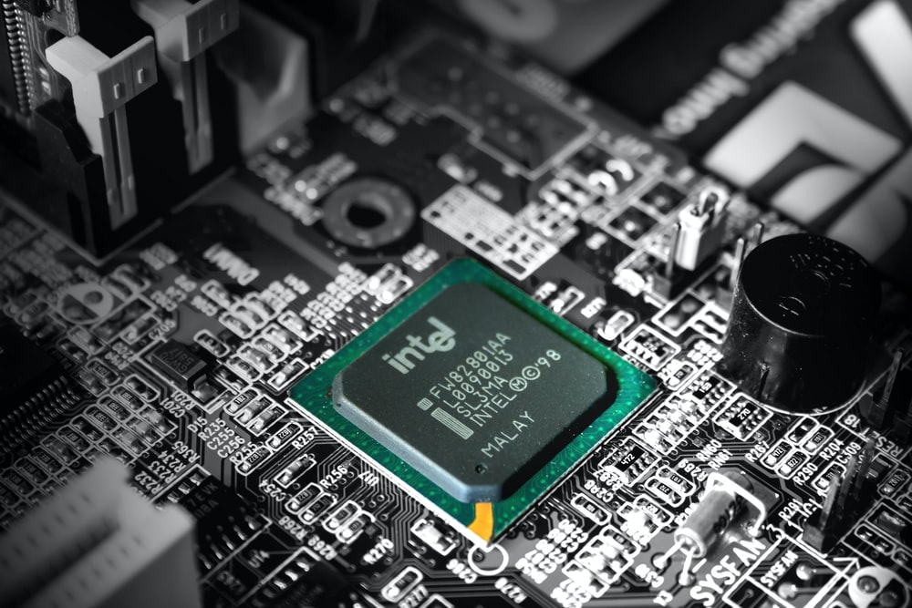
INTRODUCTION
Processors are the heart of all “smart” devices, whether they be electronic devices or otherwise.
There are generally two types of processor:
1. General purpose processors
2. Dedicated processors
General-purpose processors such as the Pentium CPU can perform different tasks under the control of software instructions. General purpose processors are used in all personal computers.

Slide 4
Dedicated processors also known as application-specific integrated circuits (ASICs) and are designed to perform just one specific task
INPUT
PROCESSOR
(CPU)
OUTPUT
MEMORY
OF BASIC PROCESSOR

Slide 5
OBJECTIVE
TO DESIGN AND SIMULATE A BASIC PROCESSOR
INCORPORATING INSTRUCTIONS USING INTEL
QUARTUS PRIME

Slide 6
LITERATURE SURVEY
1]McGregor, Tony, Pearson, Murray, Armstrong, Dean(2002). Design of a processor to support the teaching of computer systems. Proceedings of the First IEEE International Workshop on Electronic Design, Test and Applications, 2002 Volume: 1. 10.1109/DELTA.2002.994622
This paper presents a pipelined CPU design project with a field programmable gate array (FPGA) system in a computer architecture course.The goal of the project is to educate students effectively via hands-on learning. This paper was in alignment with the vision of our project. The disadvantage of this paper was that the CPU design was not structurally done. 2] Noam Nisan and Shimon Schocken, The Elements of Computing System: Building a Modern Computer from First Principles, 2005
This paper gave us a basic framework for the project’s execution. It deals with the fundamental requirements for designing a simple computer. The basic functioning of assemblers was a take away from this paper.
3]Nakano, K., & Ito, Y. (2008). Processor, Assembler, and Compiler Design Education Using an FPGA. 2008 14th IEEE International Conference on Parallel and Distributed Systems. doi:10.1109/icpads.2008.71
This paper uses a 16-bit processor TINYCPU, cross assembler TINYASM, and cross compiler TINYC. They are designed very simple and compact: The total number of lines of the source code is only 427. This paper helped us with the assembler design.

Slide 7
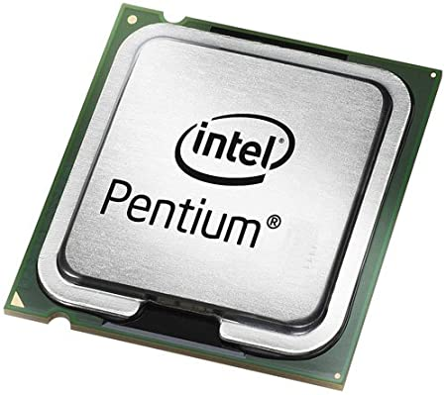
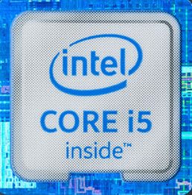

EXISTING TECHNOLOGY
INTEL PENTIUM | INTEL CORE i5 | AMD RYZEN 5
Pentium, Family of microprocessors developed by Intel Corp. Introduced in 1993 as the successor to Intel's 80486 microprocessor, the Pentium contained two processors on a single chip and about 3.3 million transistors | Developed and manufactured by Intel, the Core i5 is a computer processor, available as dual-core or quad-core. The Core i5 processor is available in multiple speeds, ranging from 1.90 GHz up to 3.80 GHz, and it features 3 MB, 4 MB or 6 MB of cache. | Ryzen 5 is a family of mid-range performance 64-bit quad and hexa-cores x86 microprocessors Introduced by AMD in March of 2017. Ryzen 5 is based on the Zen microarchitecture and is manufactured on GF's 14 nm process.

Slide 8
PROBLEM STATEMENT
Design and simulate a Simple Processor which can perform 4 basic operations, namely move(mv), move to top(mvt), addition(add) and subtraction(sub) and then integrate this simple processor into a fully functioning ARM Processor.

Slide 9
IMPLEMENTATION
It consists of Multiplexer(MUX), Arithmetic Logical Unit(ALU), Control Finite-State-Machine(Control FSM),
and Registers(Reg).
Processor
Multiplexer
Registers
Arithmetic Logical Unit
Control FSM

Slide 10
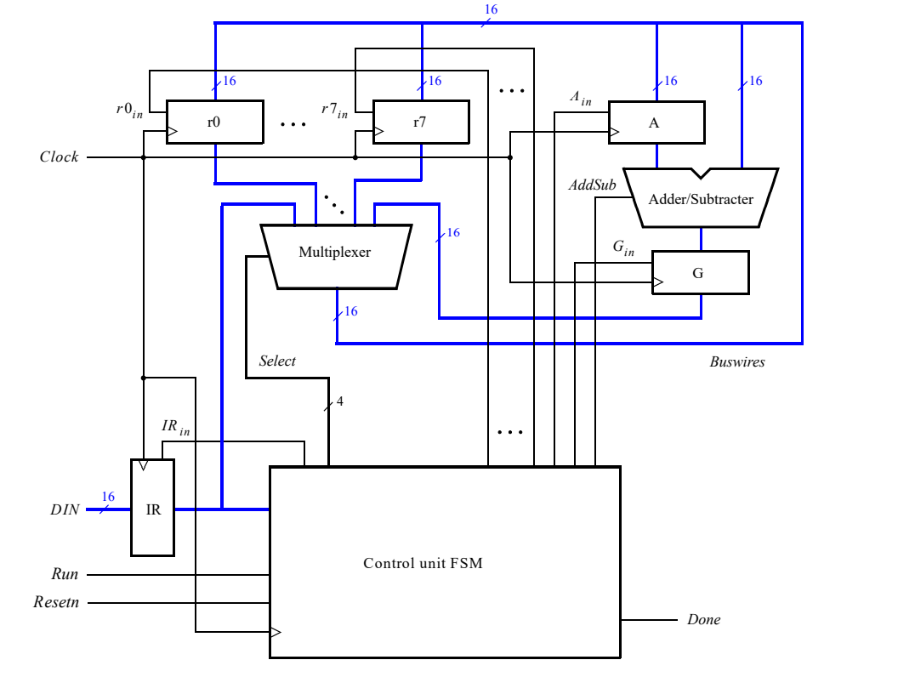
BLOCK DIAGRAM

Slide 11
HOW DOES IT WORK?

Slide 12
Specifies whether immediate addressing mode
or register addressing mode
For the immediate addressing mode,
the value is given in these 9- bits
III 0 XXX 000000YYY
Instruction Code
Specifies the register
number to be selected
for any of the 4-operations
Specifies the register
number to be selected
for the operations to be performed
Instructions are loaded from the external input DIN, and stored into the [16-bit] IR- register, using the above instruction set

Slide 13
I I I
Operations
0 0 0
mv
INSTRUCTION
TABLE
0 0 1
mvt
0 1 0
add
0 1 1
sub
1. Use MV operation to copy value to the register.
000 1 101 000011 111, value copied to r5 register
2. Again use MV operation to copy value to another register.
000 1 110 000001 111value copied to r6 register.
3. Use ADD operation two perform addition between the values of the above registers.
010 0 101 000000 110add values of r5 and r6.
For subtraction, repeat steps 1 and 2 and then use SUB operation to perform subtraction of value of r6 register from value of r5 register.
011 0 101 000000 110 subtract value of r6 from r5
STEPS TO
PERFORM ADDITION/SUBTRACTION

Slide 14
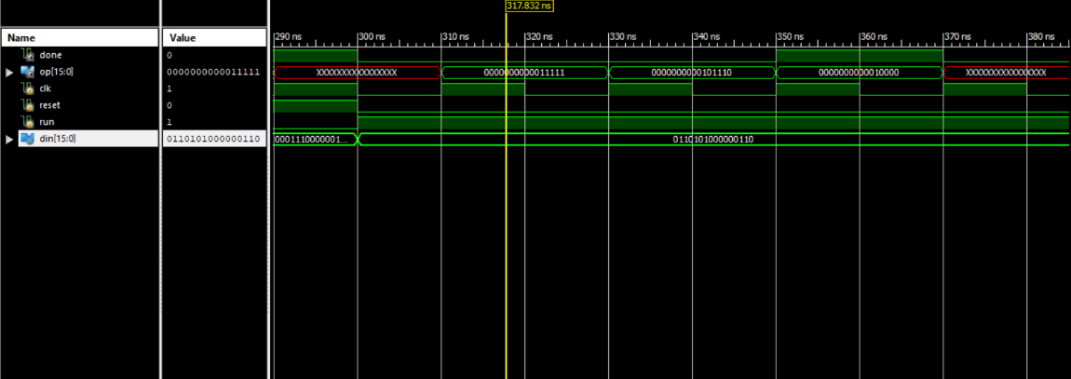
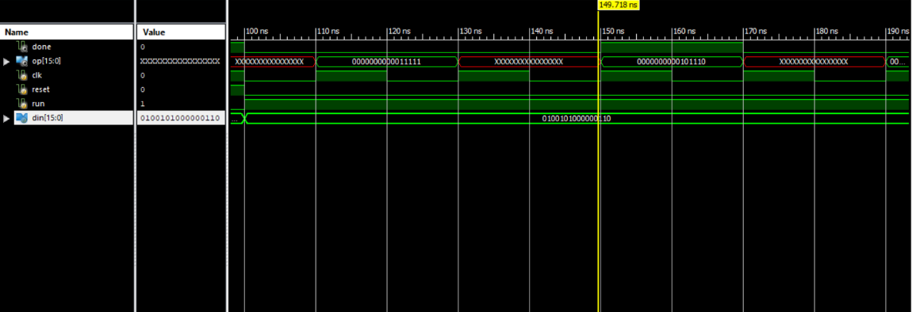
RESULTS
Fig 1: using mv instruction values copied to r5 and r6 register using Immediate Addressing Mode
Fig 2: using add instruction values of r5 and r6 register are being added

Slide 15
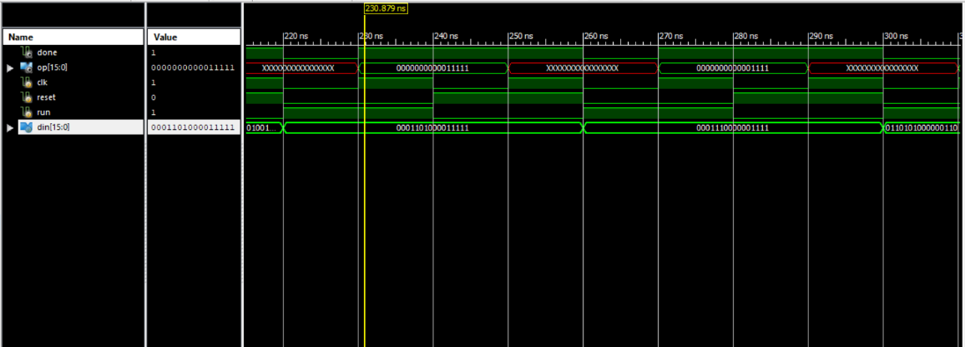
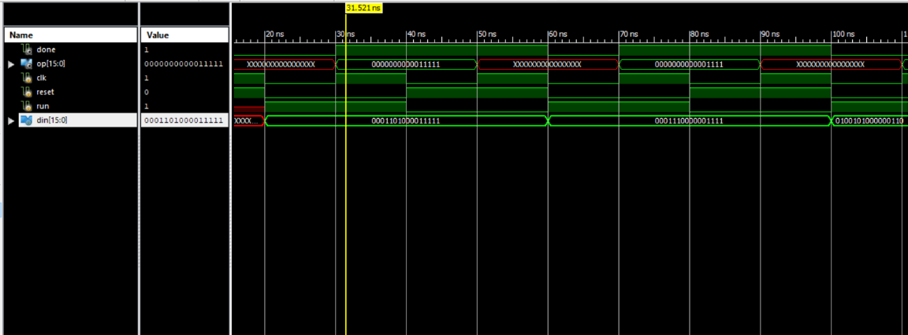
Fig 3: again using mv instruction, values copied to r5 and r6 register using Immediate Addressing Mode
Fig 4: using sub instruction, value of r6 register is being subtracted from value of r5 register.

Slide 16
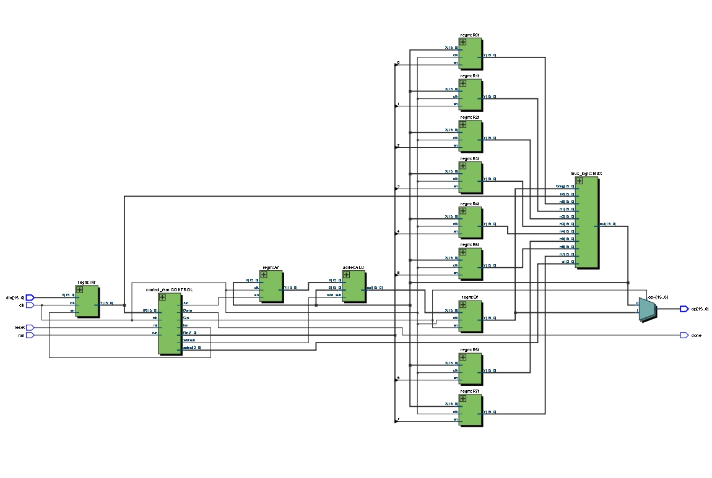
RTL SCHEMATIC

Slide 17
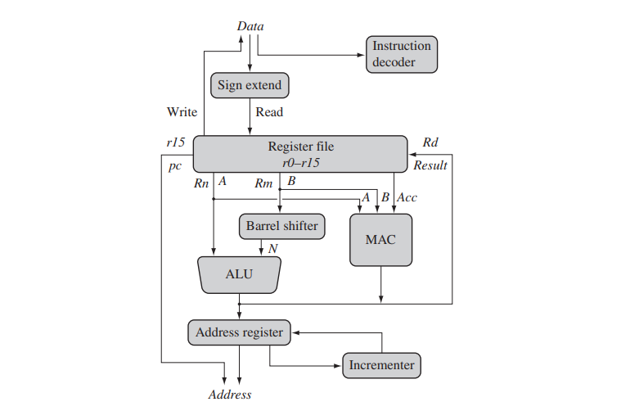
CONCLUSION AND FUTURE WORK
A simple processor was created using Verilog language which can perform 4 operations including arithmetic and shifting operations by the use of various components.
Note: The project is set to be further worked upon to integrate the simple processor into an ARM processor.
ARM Core Dataflow Model

Slide 18
THANK YOU

